Slide 1
Music Preference Analysis in Springfield and Shelbyville
Created by
Sultan Azhari

Slide 2
Proyek Description
Whenever we conduct research, we need to formulate hypotheses that we can then test. Sometimes we accept these hypotheses; but sometimes we also reject them. To make the right decision, a business needs to be able to understand whether the assumptions it makes are correct or not.
In this project, I will compare the music preferences of Springfield and Shelbyville. i will study actual Y.Music data to test the hypothesis below and compare user behavior in these two cities.

Slide 3
Objective
Testing three hypotheses:
1. User activity varies depending on the day and the city.
2. On Monday morning, Springfield and Shelbyville residents listen to different genres. This was also true for Friday night.
3. Listeners in Springfield and Shelbyville have different preferences. In Springfield, they prefer pop music, while Shelbyville, rap music has more fans.

Slide 4
Stages
The data about user behavior is stored in the file `/datasets/music_project_en.csv`. There is no information about the quality of the data, so i need to check it first before testing the hypothesis.
First, i will evaluate the data quality and see if the problems are significant. Then, during data pre-processing, i will try to take into account the most serious problems.
The project will consist of three stages:
🔎
📄
📊
1. Data Overview
2. Data Pre-processing
3. Testing the Hypothesis

Slide 5
Data Overview
Documentation about processing data would be seen via the link : https://github.com/sultanazhari/Proyek-Musik-Di-kota-Besar
This table contains seven columns. They all store the same data type: `object`.
Based on the documentation:
- `'userID'` - user identifier
- `'Track'` - track title
- `'artist'` - artist name
- `'genre'` - Genre
- `'City'` - the city where the user is located
- `'time'` - length of time the song was played
- `'Day'` - the name of the day
We can see three problems with the column name writing style:
1. Some names are uppercase, some are lowercase.
2. There is a use of spaces in some names.
3. Use of compound names that are not separated by 'underscore(_)'.
The number of column values is different. This means the data contains missing values.

Slide 6
Methodology
Start
Data Overview
Data Pra-Processing
Rename the column based on good writing style rules
Revised the inappropriate genre names
Drop Duplicate value (5,9% Duplicate data)
Replace missing data with "uwnknown" using nested loop
Found a missing value : - 13% in Artist Column - 2,1% in Track Column
- 1,9% in Genre Column
Develop a function for revised inappropriate name in value. to be used in the future.
Finish

Slide 7
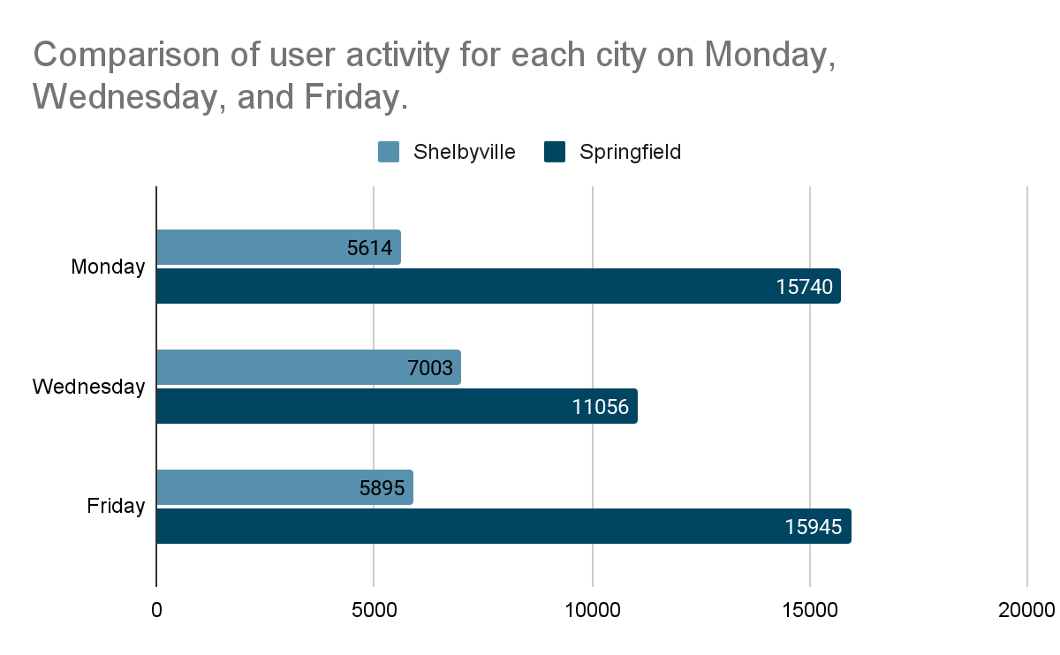
User activity varies depending on the day and the city.
Evaluation of user activity in each city
City | User activity
Shelbyville | 18,512
Springfield | 42,741
Evaluation of user activity on each day
Day | User activity
Monday | 21,354
Wednesday | 18,059
Friday | 21,840
Key Findings - In Springfield, the number of songs played peaked on Monday and Friday, while Wednesday saw a drop in activity.
- In Shelbyville, on the other hand, users listen to more music on Wednesdays.
Hypothesis acceptable

Slide 8
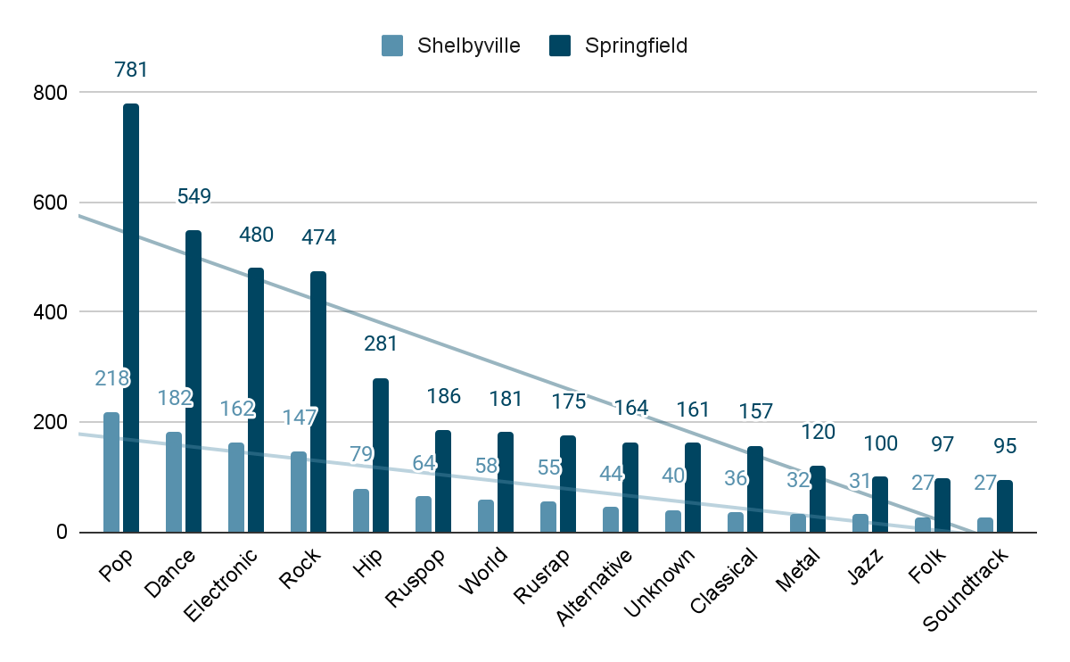
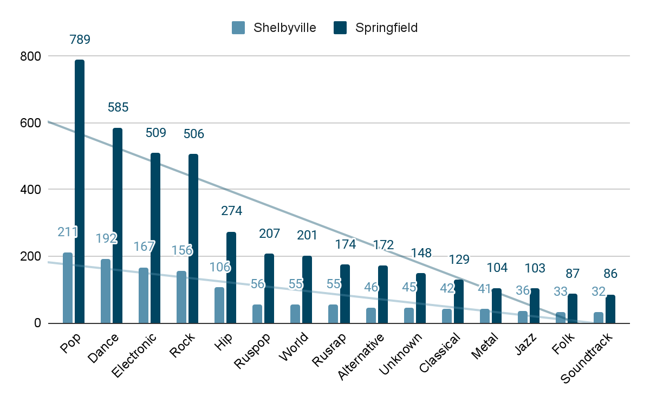
2. On Monday mornings and Friday nights, Springfield residents listen to a different genre
Monday Morning
Friday Night
Key Findings
- In both Springfield and Shelbyville, People listen to a same genre in Monday Morning and even in Friday Night.
Hypothesis not acceptable

Slide 9
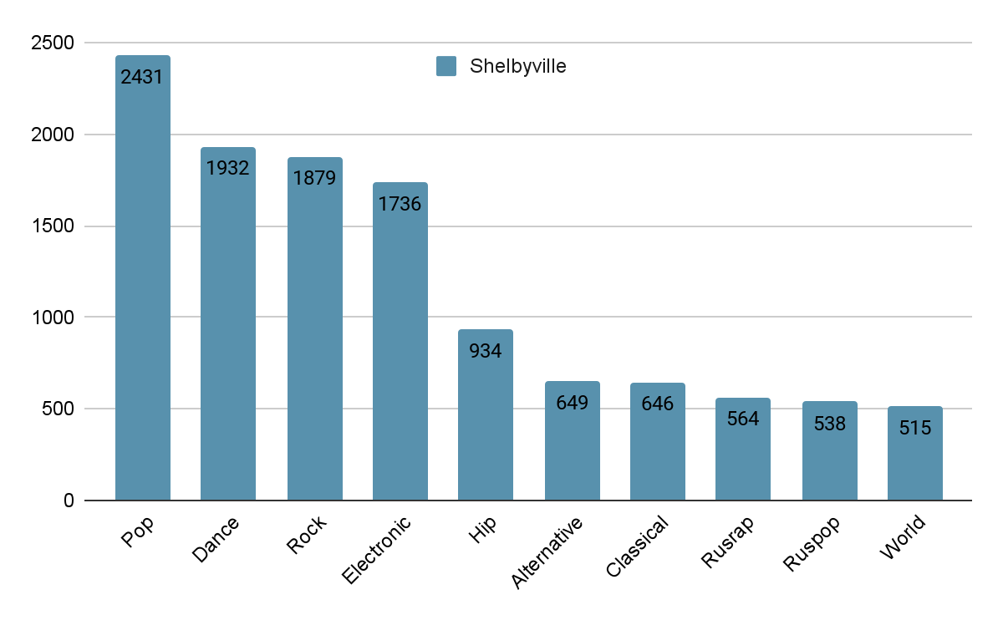
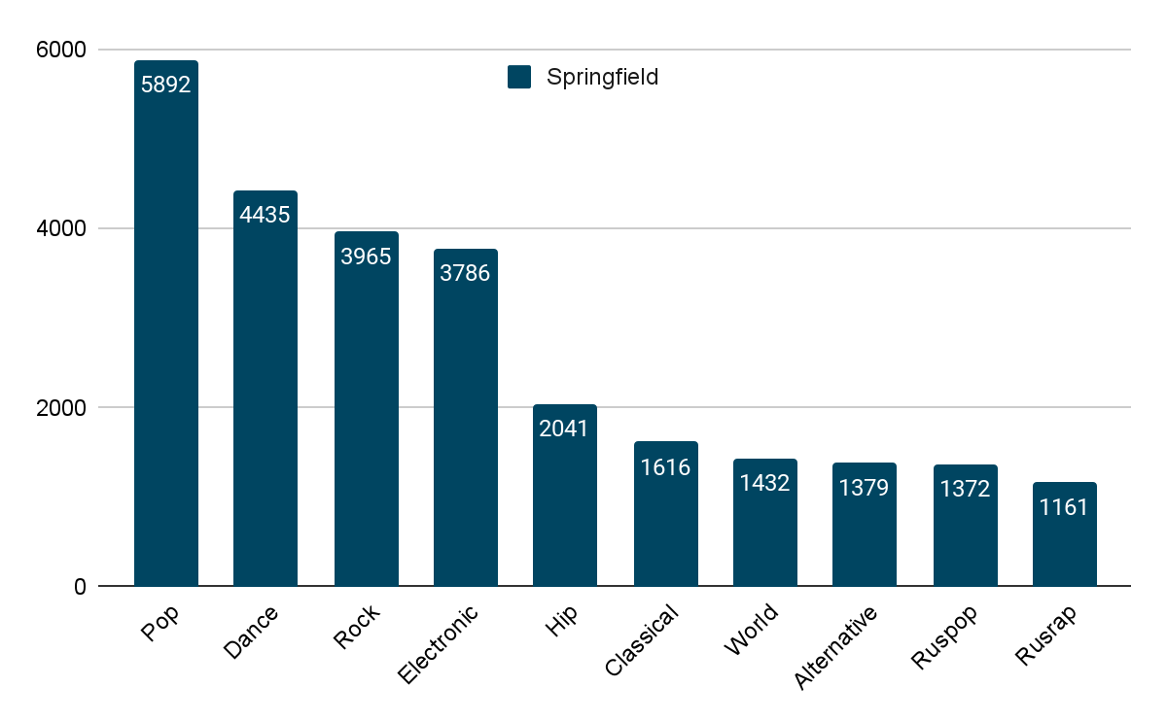
3. Listeners in Springfield and Shelbyville have different preferences. In Springfield,
they prefer pop music,while Shelbyville, rap music has more fans.
Top 10 Genre in Shelbyville
Top 10 Genre in Springfield
Key Findings
- It was recognized that the music preferences of users from Springfield and Shelbyville were very similar.
Hypothesis not acceptable

Slide 10
Conclusion
We have tested the following three hypotheses:
1. User activity varies depending on the day and the city.
2. On Monday morning, Springfield and Shelbyville residents listen to different genres. This is also true for Friday night.
3. Listeners in Springfield and Shelbyville have different preferences. In both Springfield and Shelbyville, they prefer pop music.
After analyzing the data, we can conclude:
1. User activity in Springfield and Shelbyville depends on the day, even though the cities are different.
The first hypothesis is fully accepted.
2. Music preferences are not very different during the week in Springfield and Shelbyville. We can see a small difference in the order on Monday. In both Springfield and Shelbyville, people listen to the most pop music.
So we cannot accept this hypothesis. We should also keep in mind that the results could have been different if not for the missing values.
3. It turns out that the music preferences of users from Springfield and Shelbyville are very similar.
The third hypothesis is rejected. If there is a difference in preferences, it cannot be seen from this data.

